Slide 1
ECE901
Dimitris Papailiopoulos
Scaling-up SGD with mini-batches

Slide 2
Today
Synchronous Distributed Optimization
Distributing SGD effort with minibatches
Performance of Distributed SGD

Slide 3
Stochastic Gradient Descent
Idea (‘50s, ‘60s [Robbins, Monro], [Widrow, Hoff]):
Sample a data point + locally optimize.
loss for data point i
SGD: An Über-algorithm

Slide 4
Stochastic Gradient Descent
SGD can take 10+ days on large data sets
[DawnBench, 2017]
Goal:
Speed up Machine Learning

Slide 5

Idea:
Train at scale

Slide 6
Minibatch SGD

Slide 7
Synchronous computation

Slide 8
Algorithm of choice: minibatch SGD

Slide 9
Algorithm of choice: minibatch SGD
Stores the model
Gradient Computations

Slide 10
Algorithm of choice: minibatch SGD

Slide 11
Algorithm of choice: minibatch SGD
B = batch size,
gradients / iteration

Slide 12
Algorithm of choice: minibatch SGD

Slide 13
Algorithm of choice: minibatch SGD

Slide 14
Algorithm of choice: minibatch SGD
Repeat distributed iterations until
we are happy with the model

Slide 15
Simple idea
Compute multiple gradients in parallel
Issue:
all 4 gradients computed on the same model
Q: Does it perform the same as SGD?

Slide 16
Evaluating the performance of Distributed ML

Slide 17
Many Questions….
How fast does minibatch-SGD converge?
How can we measure speedups?
Comm. is expensive, how often do we average?
What happens with delayed nodes?

Slide 18
How to analyze parallel algorithms?
Main measure of performance
Example: Gradient Descent
Embarrassingly Parallel O(#cores) speedup
Serial
Parallel
Not true for mini-batch SGD
- Convergence is invariant of allocation
Both algorithms reach to same accuracy after T iterations
Speedup is independent of covergence rate

Slide 19
How to Analyze mini-batch?
Measure of performance
Main Question:
How does minibatch SGD compare against serial SGD?

Slide 20
How to evaluate run-time
Two factors control run-time
Time to accuracy ε =
[time per data pass] X [#passes to accuracy ε]

Slide 21
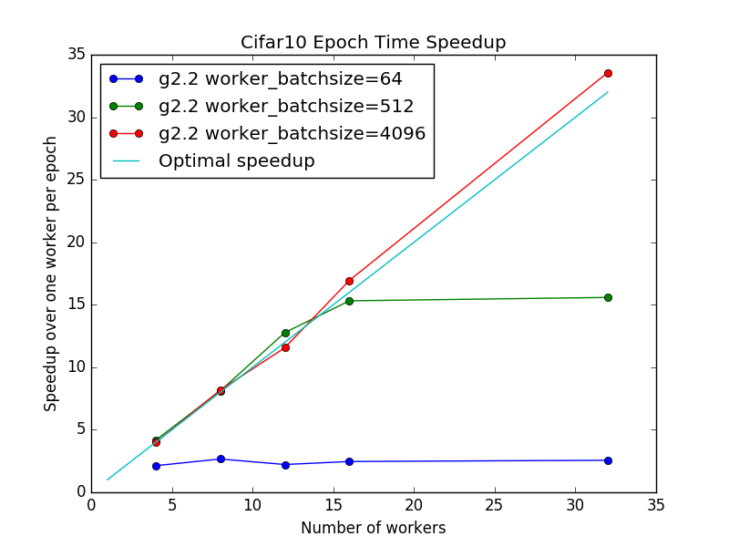

Per iteration time
TL;DR: Becomes better with larger B
Why?
Time per pass:
time for dataset_size/batch_size distributed iterations
Bigger Batch
Less Communication
(smaller time per epoch)

Slide 22
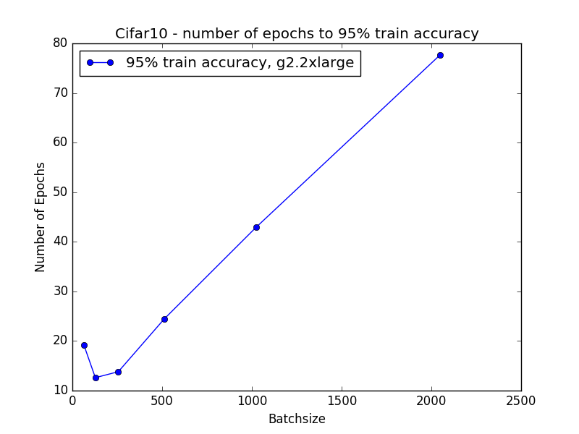
Number of passes to ε accuracy
TL;DR: Becomes worse with larger B
Large Batch
worse train error
(more #passes to accuracy ε)
WHY?

Slide 23
Convergence of mini-batch SGD
Main question:
How does mini-batch SGD compare to1-sample SGD?
Idea: Compare T iterations of 1-sample SGD with T/B iterations of minibatch SGD
Hope: under some assumptions* updating the global model every B gradients is not a big issue.

Slide 24
A single iteration of 1-sample SGD
Progress in a single iteration:

Slide 25
A single iteration of 1-sample SGD
Progress in a single iteration:
When mini-batch SGD “works”, you’d expect B times more progress!

Slide 26
Single iteration of B-sample SGD
Progress in a single mini-batch iteration:
How does it compare in expectation with 1-sample SGD?

Slide 27
Single iteration of B-sample SGD
“Progress” is equal to:
The variance is equal to:

Slide 28
Single iteration of B-sample SGD
“Progress” is equal to:
The variance is equal to:

Slide 29
Single iteration of B-sample SGD
“Progress” is equal to:
The variance is equal to:

Slide 30
Single iteration of B-sample SGD
“Progress” is equal to:
The variance is equal to:

Slide 31
Mini-batch Progress
Progress in a single mini-batch iteration:
Let’s compare with SGD!

Slide 32
Single iteration of B-sample SGD
1-sample SGD Progress:
B-sample SGD Progress:
“Extra variance” term directly controlled by B

Slide 33
Single iteration of B-sample SGD
B-sample SGD Progress:
Simple idea: Make B so that the extra term is smaller than
Set

Slide 34
Single iteration of B-sample SGD
If
We get
1- sample SGD gets:
B times more progress! (approximately)

Slide 35
Notation
Sum of grad norms:
Gradient Diversity:

Slide 36
Main Result
Main Theorem (assumption-less!)
Remarks:
This is a local lemma
True for both global, local min, and critical points
It’s universal! (no assumptions, always true)

Slide 37
Main Result
Corollary:
If you set batch-size proportional to grad diversity, you’re good!

Slide 38
Gradient Diversity
Gradient Diversity:
Measures similarity between gradients
Big Diversity: Larger batches => better speedups
Small Diversity: Smaller Batches => worse speedup
Examples:
1. All gradients are orthogonal, Diversity = 1
2. All gradients identical, Diversity = 1/n

Slide 39

High-level idea: “Similarity Hurts”
“similar” gradient updates
Having workers computing identical gradients is useless! => no speedup

Slide 40
Lower Bounds
Gradient Diversity in Practice
Theorem:
There exists problems where the bound on is tight, and higher batch-size leads to slower convergence
We can’t increase the Batch size beyond a point
without sacrificing speedups

Slide 41
Gradient Diversity in Experiments
CIFAR-10 (cuda conv-net)
Q: Mechanisms to increase diversity?
Smaller diversity => slower convergence

Slide 42
Many more Questions….
Generalization?
What happens with delayed nodes?
Comm. is expensive, how often do we average?

Slide 43
Generalization?
Do models trained with minibatch SGD generalize
Alexnet on Imagenet

Slide 44
Next Time
Asynchronous Optimization
Stragglers
Hogwild

